Slide 1
ICAI MOBILE APP
CPE Programs Module

Slide 2
Main Features
ICAI brings yet another revolution in disseminating information regarding CPE activities by developing a CPE segment with the title “CPE Programs” on ICAI Mobile App. In the first phase, it has been functional through android platform and based on the feedback / response the same would also be developed for IOS platform shortly. It contains the following main features:
Details of upcoming programs
Know your CPE hours credit
Register for program alert
Online Submission of Unstructured Learning Activities
Receiving notifications regarding program alerts and CPE hours credit
View CPE Webcasts, CPE e-newsletters

Slide 3
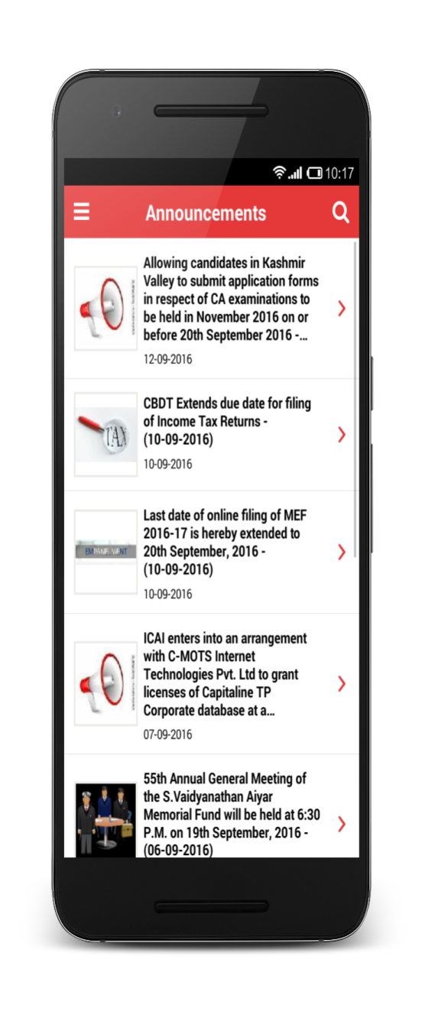
Splash & Home Page

Slide 4
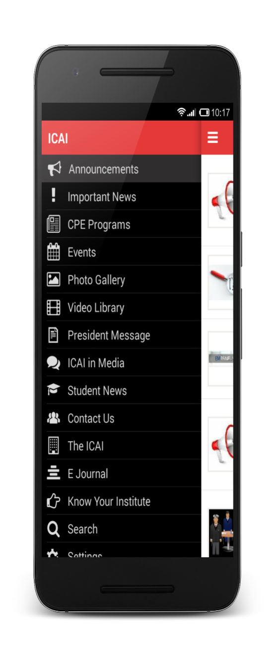
CPE Programs Module in Left Menu

Slide 5
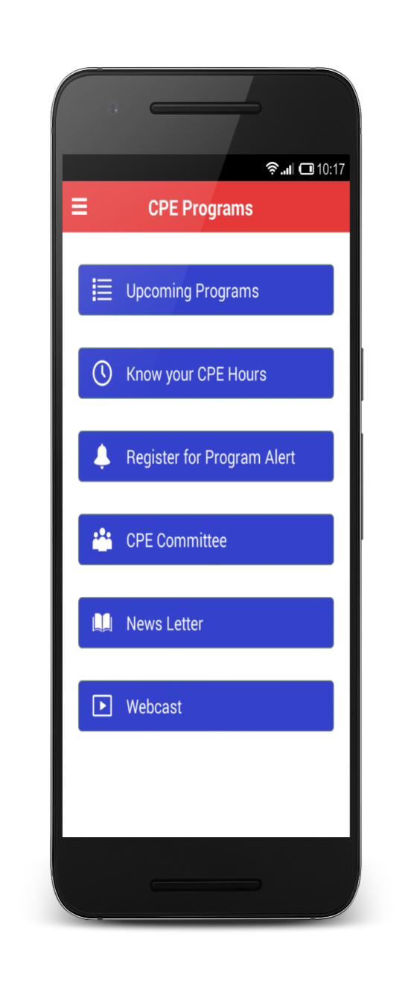
CPE Programs Main Screen

Slide 6
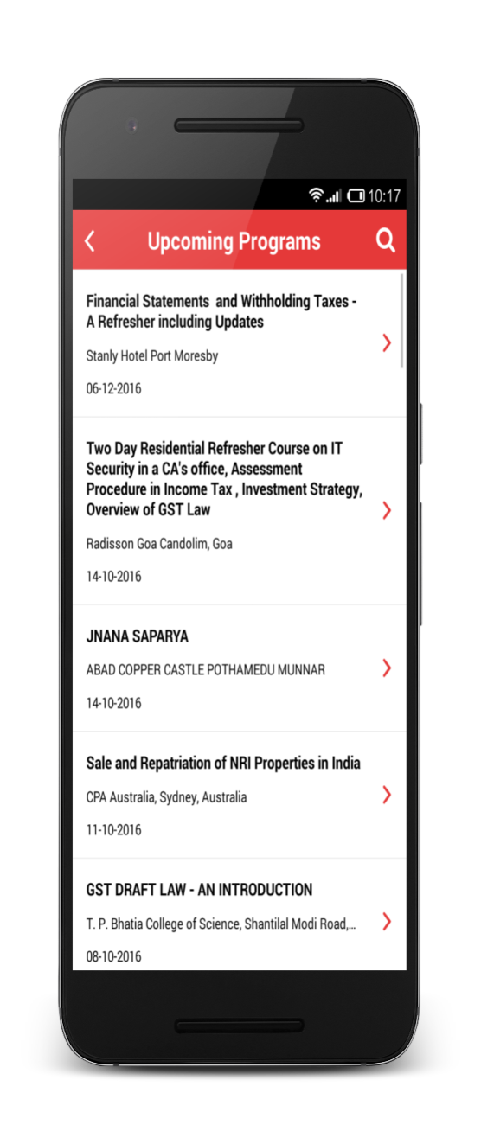
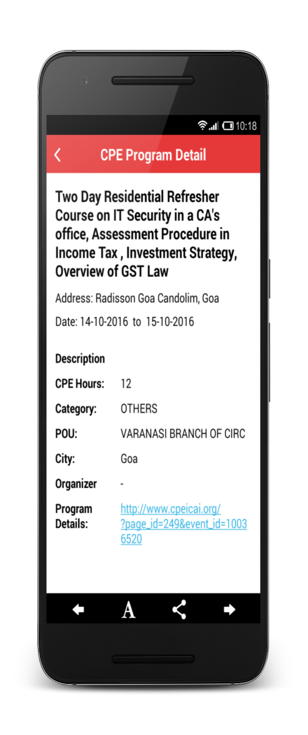
Upcoming Programs

Slide 7
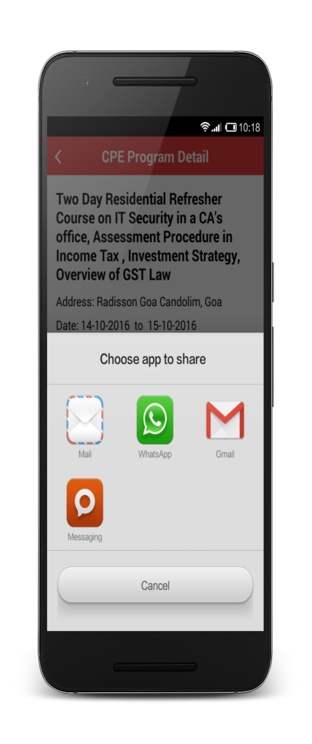
CPE Program Detail

Slide 8
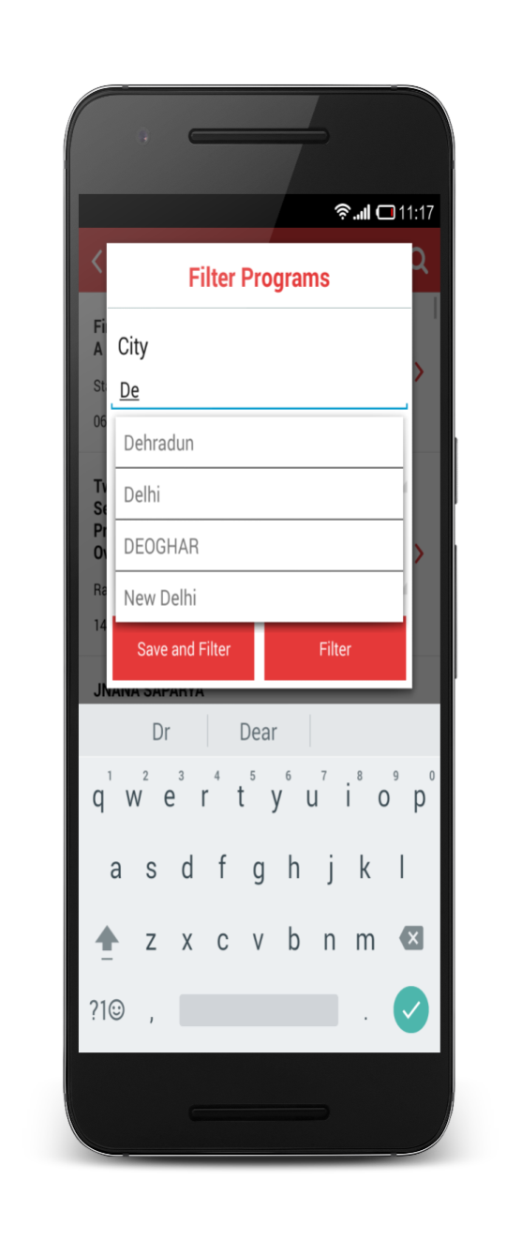
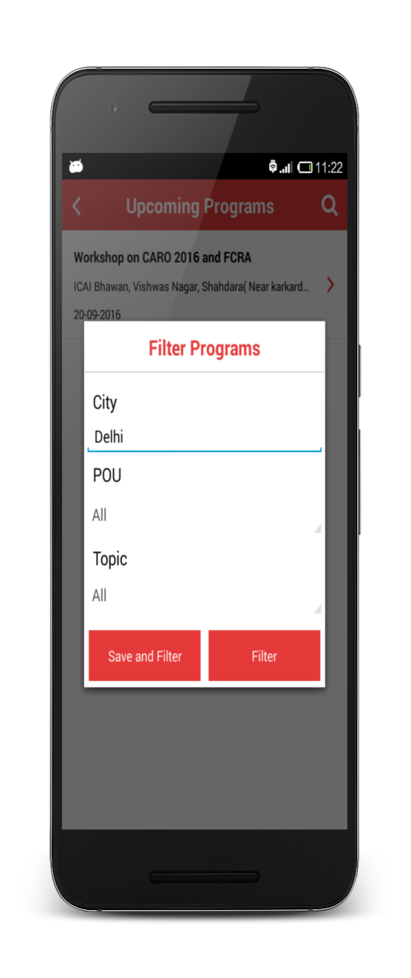
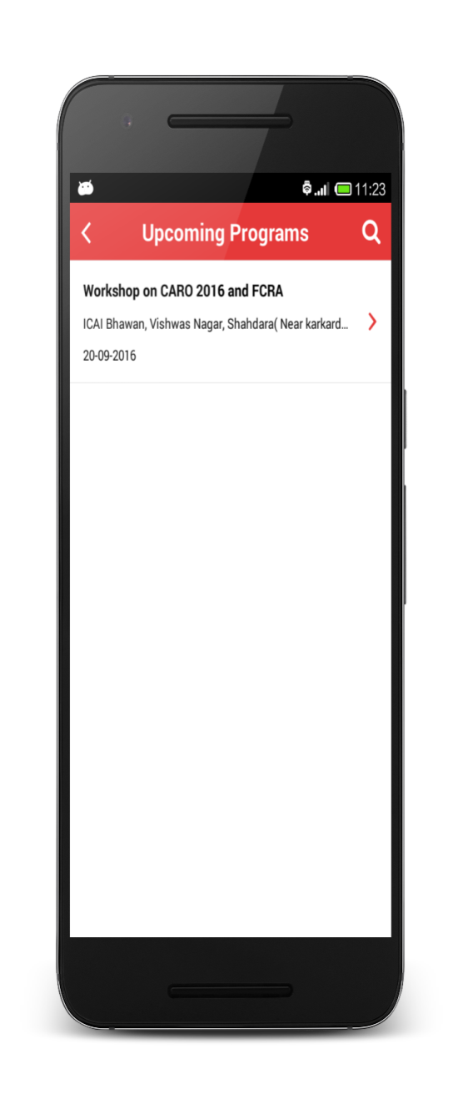
CPE Program Search

Slide 9
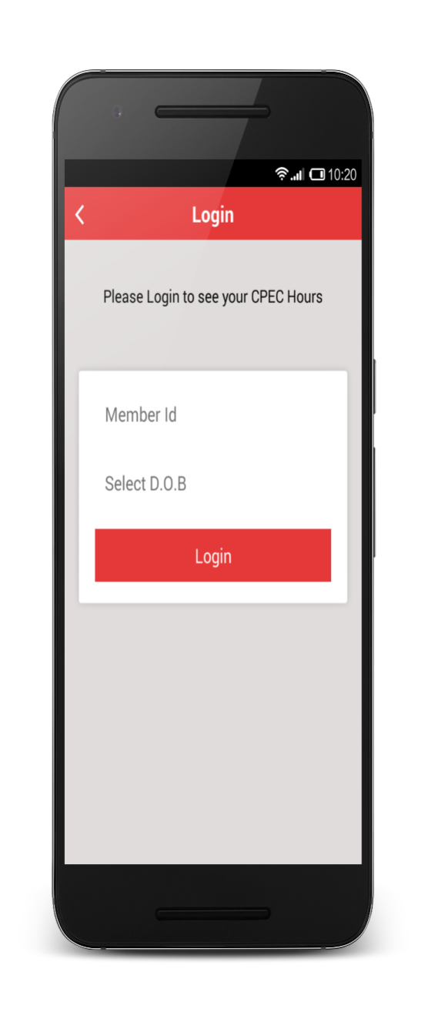
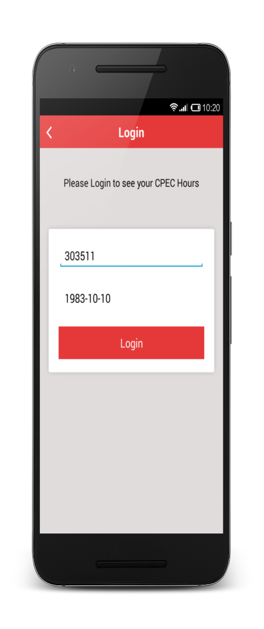
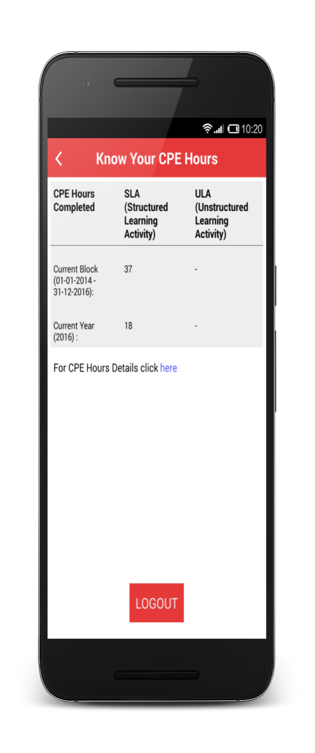
Know your CPE Hours

Slide 10
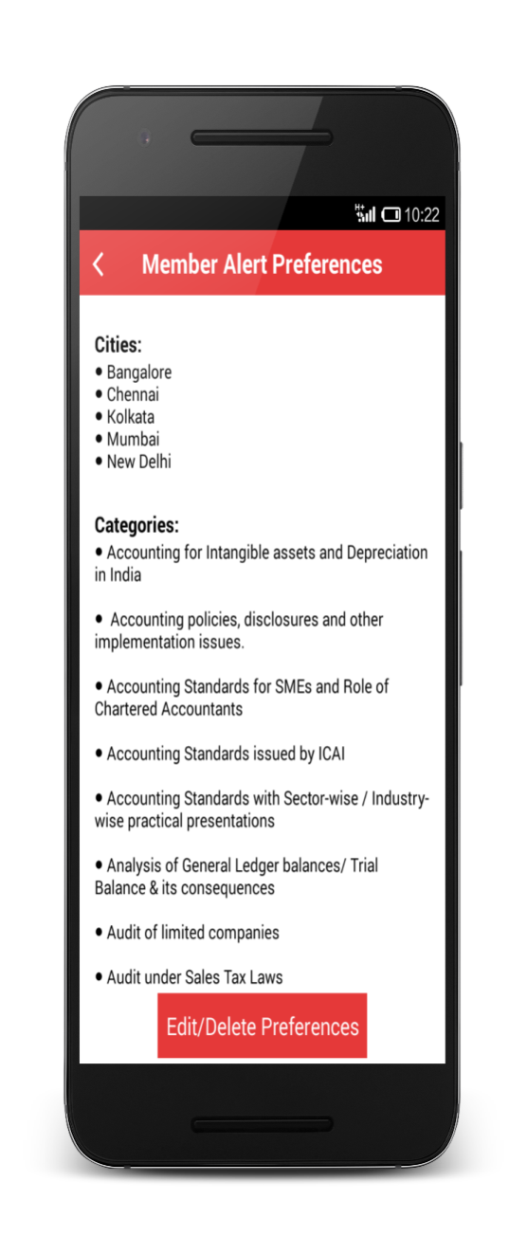
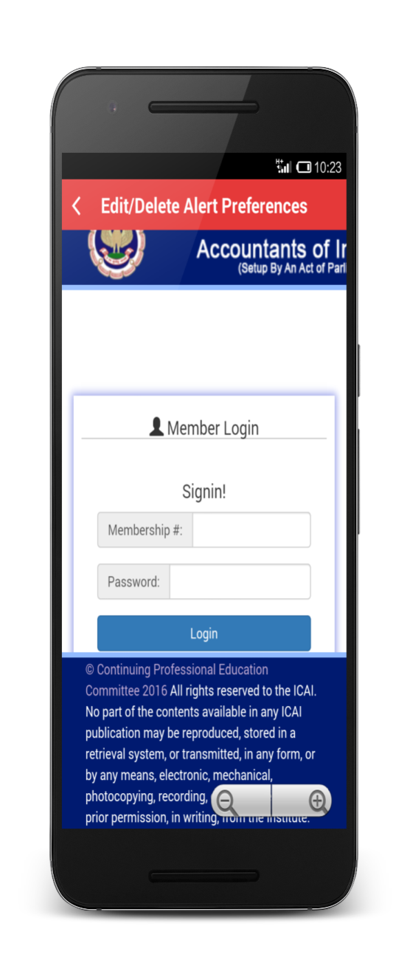
Program Alert Preferences

Slide 11
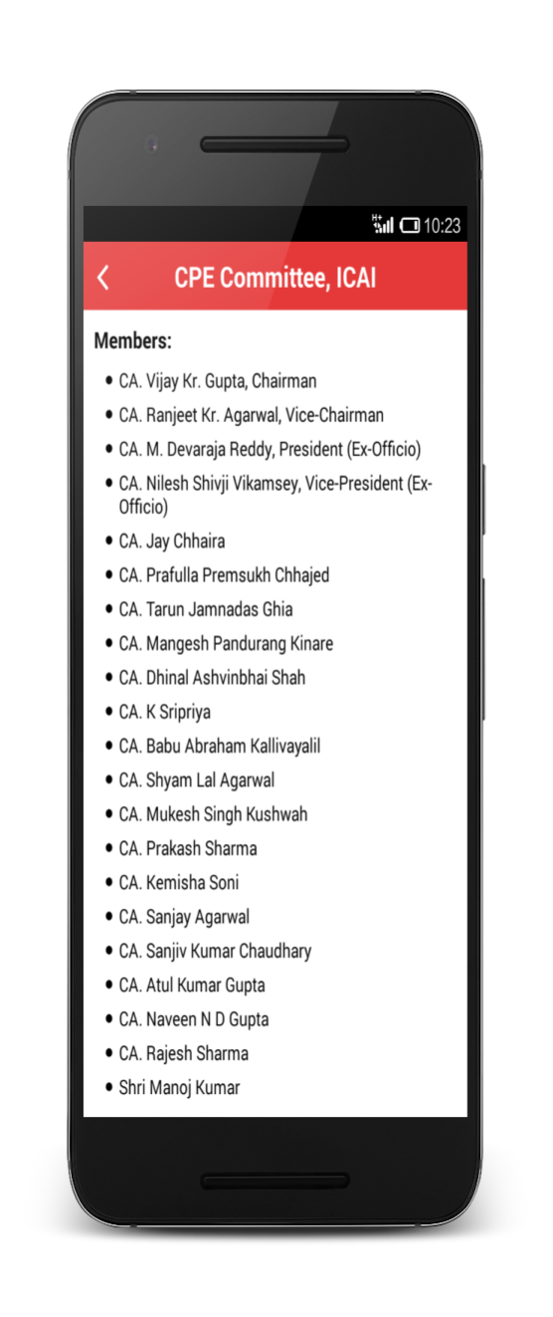
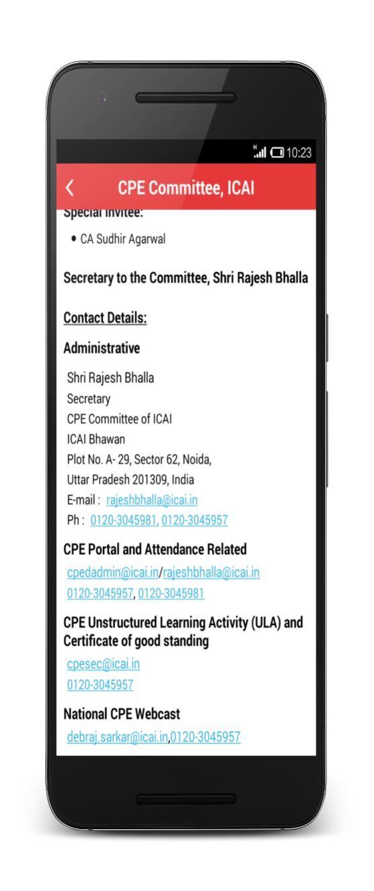
CPE Committee

Slide 12
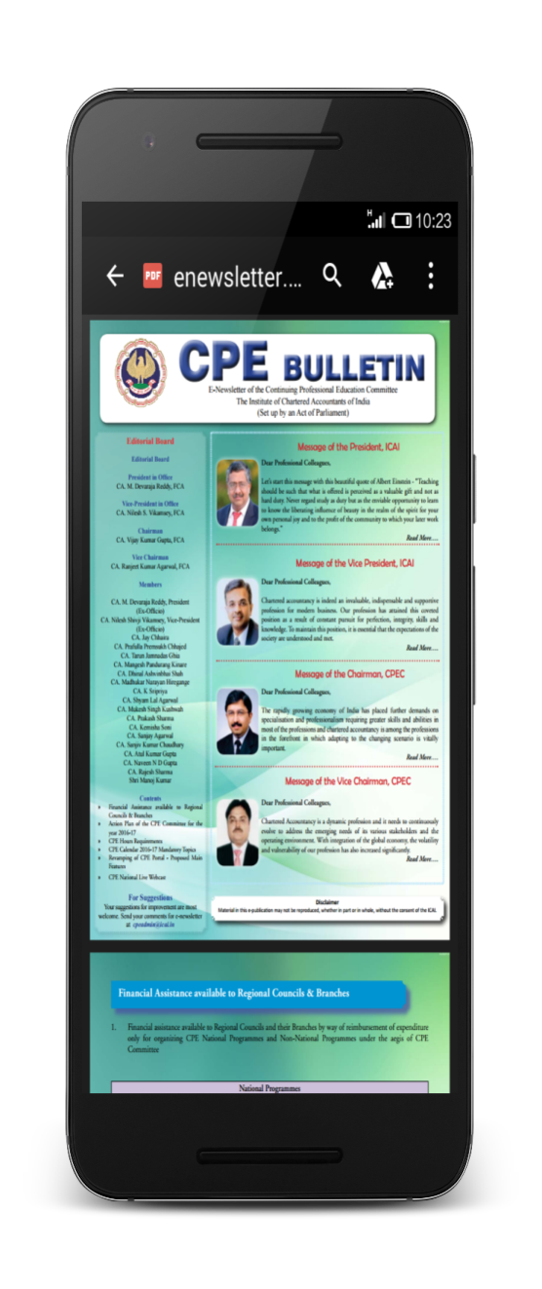
News Letter

Slide 13
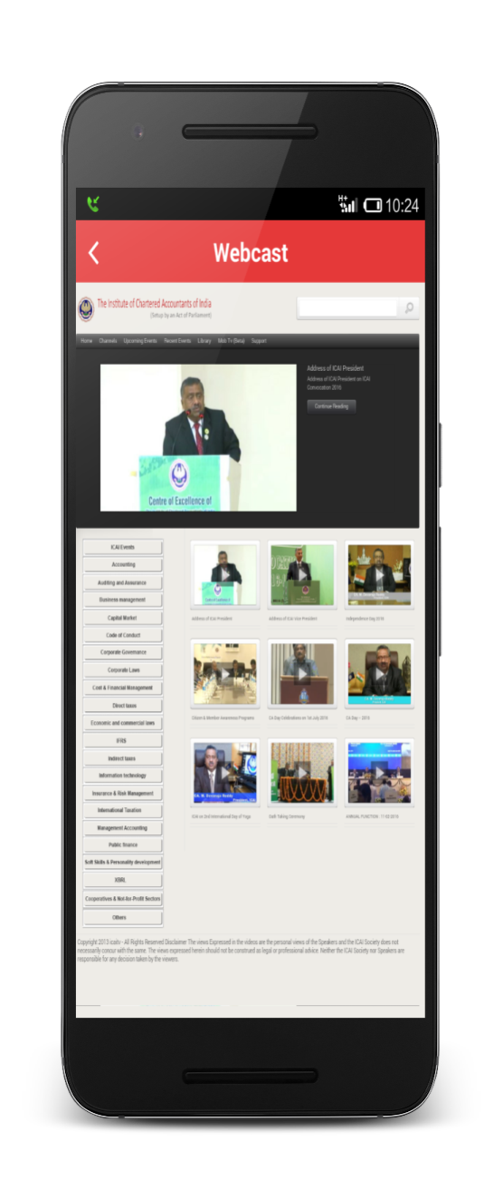
Webcast

